Slide 1
Enterprise Business Intelligence and Dashboards
Available in the cloud https://my.infocaptor.com
Available as download http://infocaptor.com
Business Intelligence Platform
for building
Stunning Reports
and
Dashboards

Slide 2
Benefits
Dynamic Visual Dashboards
Gain Quick Insights into your Business
Bird’s Eye view of entire operation
Track important social metrics

Slide 3
Benefits
InfoCaptor brings gaming elements into Dashboards
Dashboards can now sing and dance
Visual Alerts
Motion Alerts
Sound Alerts
Email Alerts
Dashboards can now be really fun to use

Slide 4
Sample Dashboards and Usage Scenarios

Slide 5
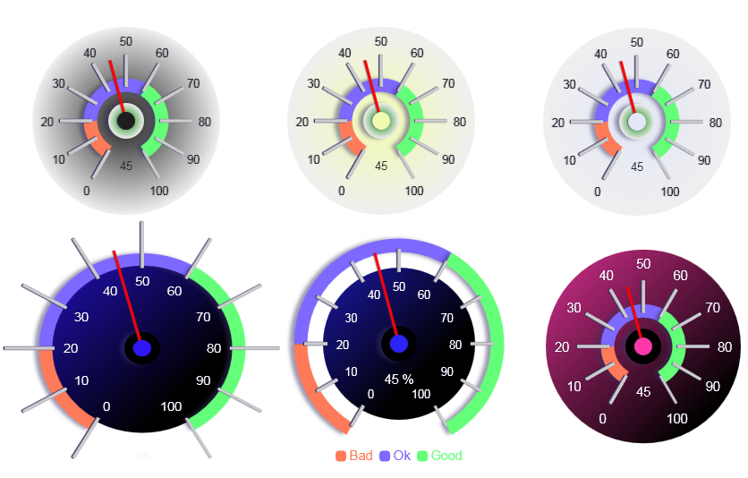
Beautiful Gauges with variety

Slide 6
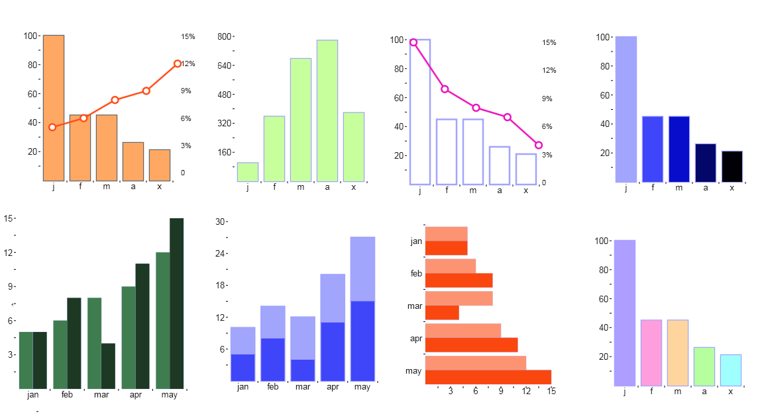
Bar Charts – unlimited combinations – Perfect for trends

Slide 7
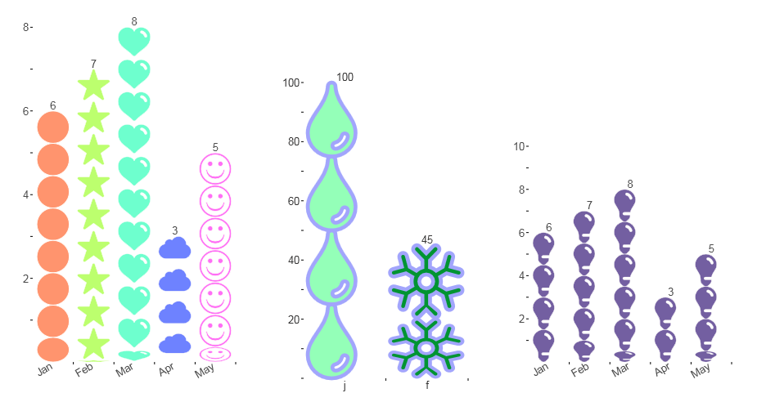
Bar Charts – with icons

Slide 8
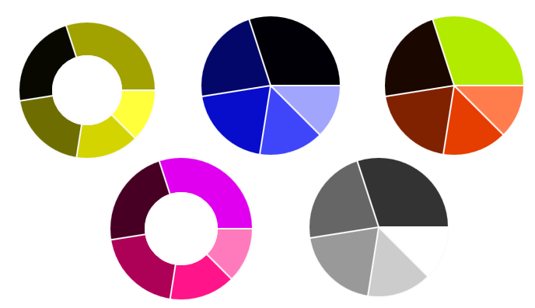
Pie and donut charts – useful for shares, splits and distributions

Slide 9
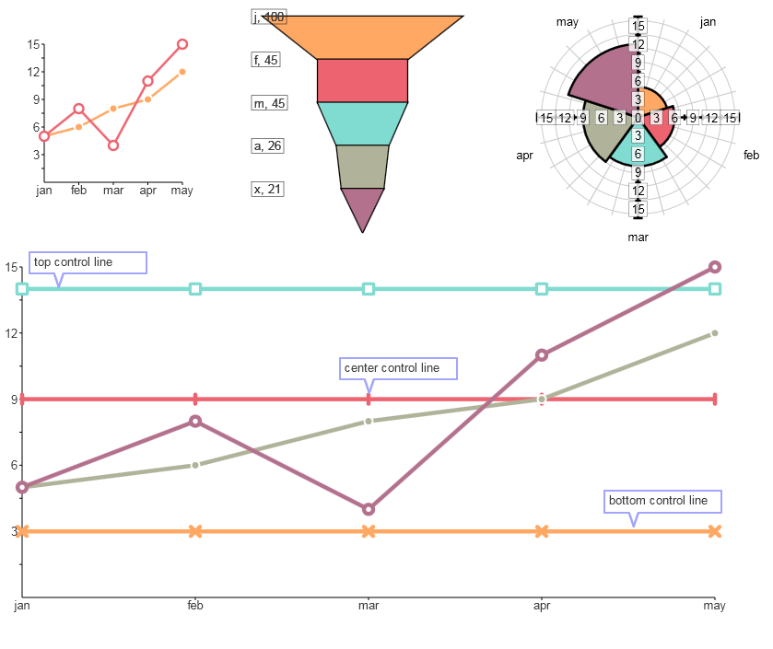
Line chart, Funnels and radar chart

Slide 10
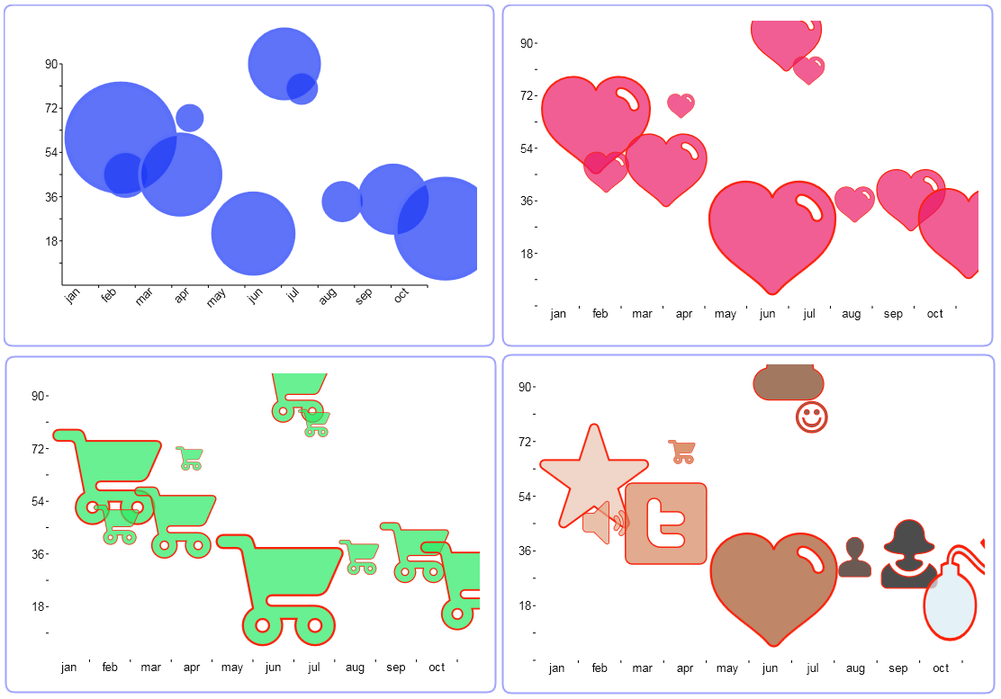
Bubble charts with symbols and icons

Slide 11
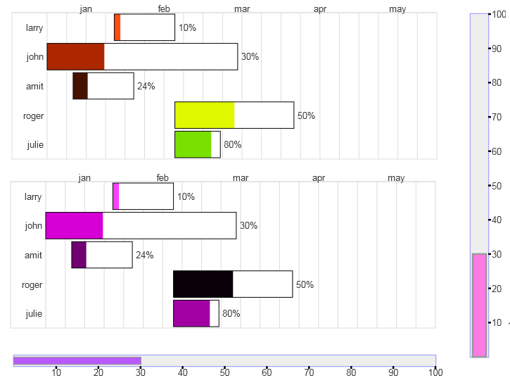
Gantt chart, Horizontal and vertical progress bars

Slide 12
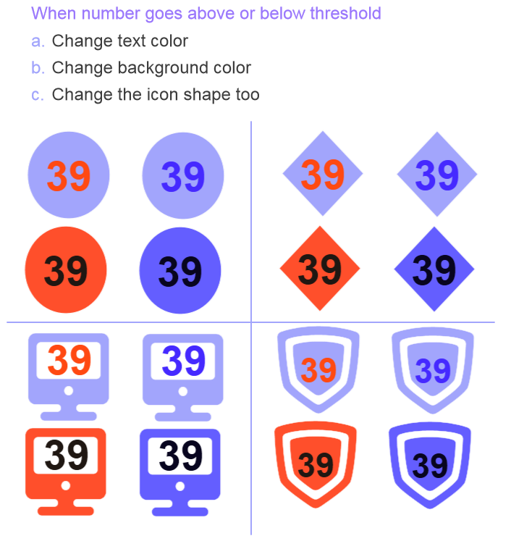
Custom widgets with icons

Slide 13
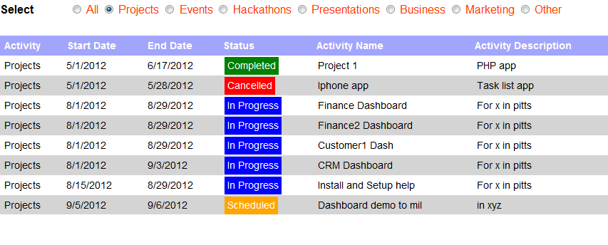
Exception reporting
Format any data cells based on thresholds you set

Slide 14
GFX and sound effects with email alerts
When you wish to notify of any data change you can alert in multiple ways
Change colors
Shake or dance the widgets
Play a sound or siren
Email to people

Slide 15
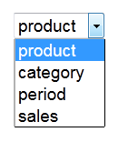
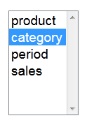
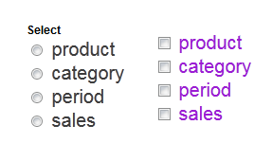
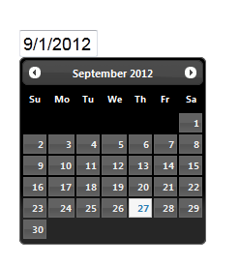
Dashboard controls slice and dice data
Drop down single and multi select
Radio and checkboxes
Text Fields
Date Picker

Slide 16
Human Resource Dashboard
Easy Interactive controls and unlimited Drill down options

Slide 17
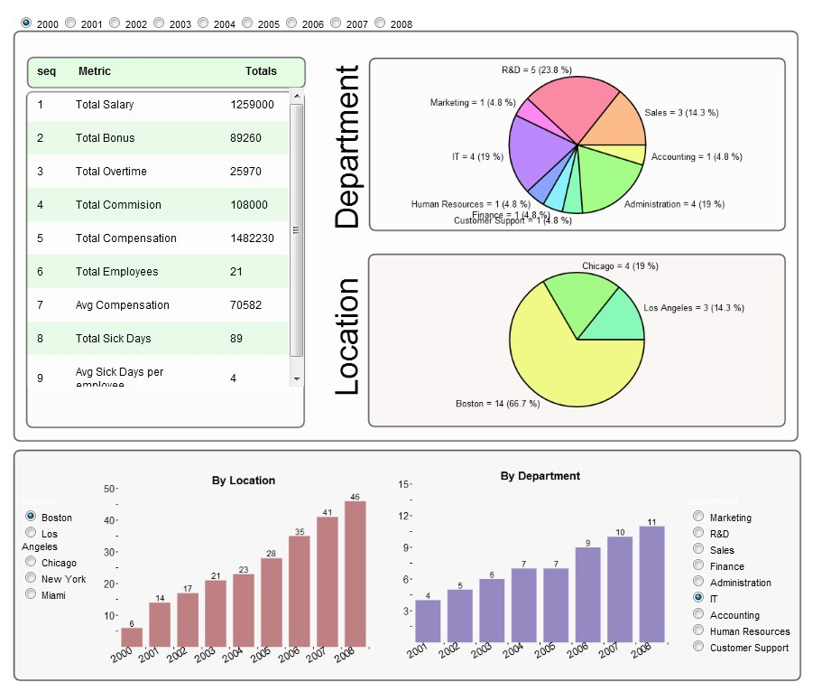
Simple dashboard look and feel
Drill down from pie chart to bar charts

Slide 18
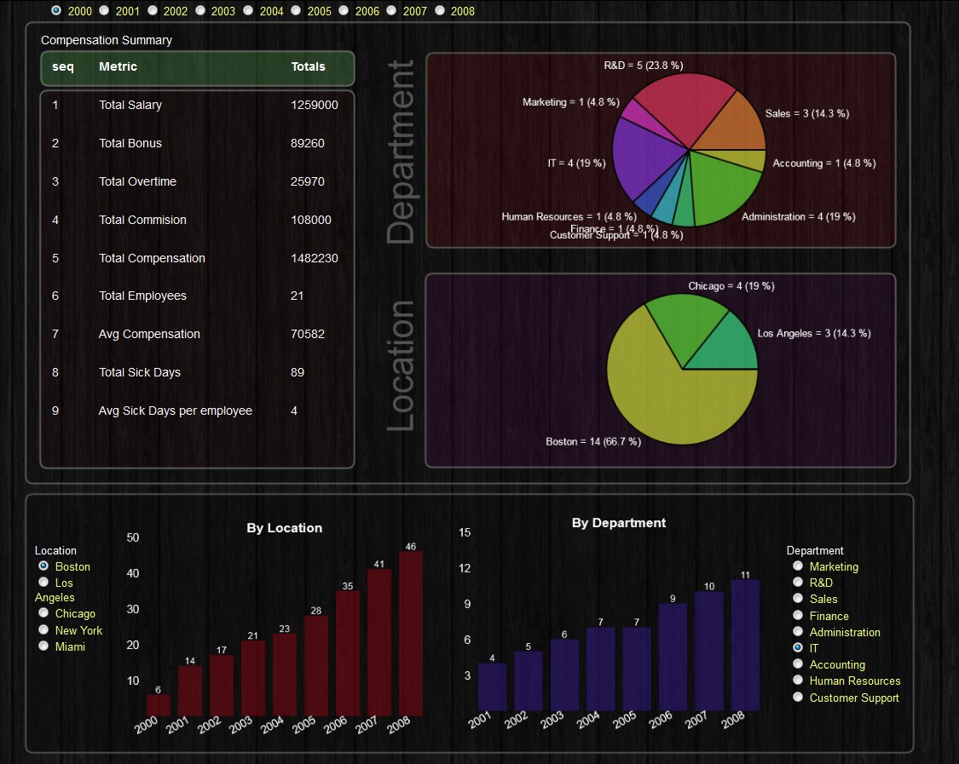
Dashboard on a dark wooden background

Slide 19
Dashboards on TV – Realtime
Put dashboards on Big screen TV and have fun with Data

Slide 20
Track Facebook Metrics
Display information on any widget such as Sticky Notes

Slide 21
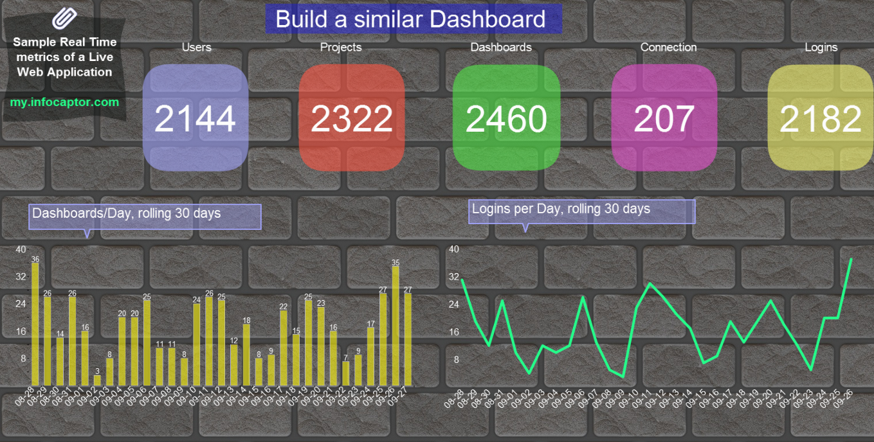
Modern style dashboard
Display information on any widget such as Sticky Notes

Slide 22
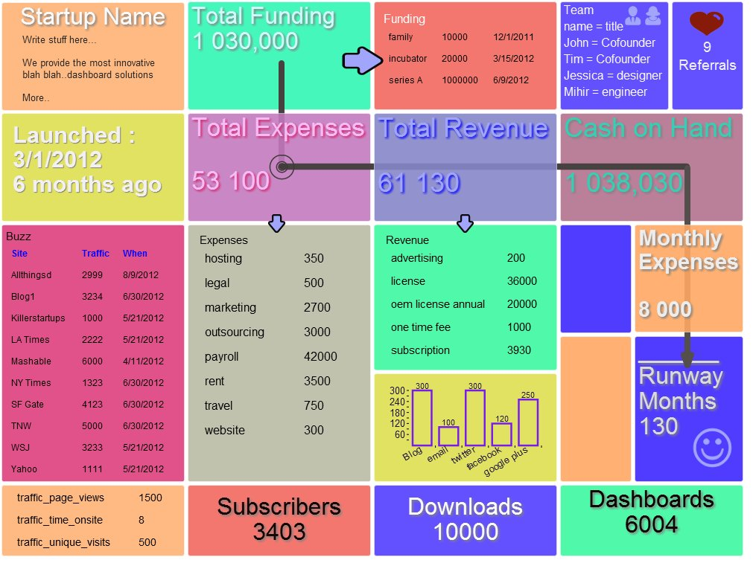
Windows 8 Styled Dashboard

Slide 23
Track Financial Metrics

Slide 24
Personal Health Dashboard

Slide 25
Inflation Dashboard

Slide 26
Features
Global filters/prompts for slicing
Drill down from one chart to another
Drill down from one dashboard to another
Bring information from multi data sources into one page view
Built in Flowchart engine
Built in prototyping engine
Data-aware widgets, each and every widget (including flow chart lines) can show any information
Logical groups for functional purpose (e.g sales, finance, marketing etc)
Easy sharing of projects and dashboard between groups and users
Enterprise grade user access control
LDAP Integration/authentication

Slide 27
Flowchart engine
InfoGraphic style dashboards are easier to digest and understand. The flowchart engine allows for building live infographics
Indicate a flow of information using flowchart lines and symbols
Use it for building static flowcharts

Slide 28
Action Framework
Provide multiple ways to interact with controls
Controls can filter/slice and dice data
Data widgets can pass information back to other widgets
Provide unlimited Drill down within the same dashboard or external applications
Each and every widget/chart/grid has the capacity to control other child widgets

Slide 29
Capture Database information
Connect to any SQL database directly
Oracle
MySQL
SQL Server
DB2
SQLite
PostgreSQL
Excel
Access
Any database supporting ODBC or JDBC

Slide 30
Capture any information
Connect to any Web service
Extract information from XML using xpath (http://www.infocaptor.com/help/xml.htm)
HTTP Post
HTTP Get
JSON/XML/HTML/Text data types
Write your own API and fetch using POST/GET

Slide 31
HTML5 Charting Engine
BI vendors like Oracle and Microstrategy use Flash for the charting engine
This gives inconsistent experience between desktop and mobile display
InfoCaptor charting is built on top of HTML5 and shows the same both on desktop or mobile
Looks the same on your iPad or iPhone

Slide 32
Prebuilt Social Metrics
Just provide your URL or ID and start tracking metrics from social accounts
Facebook (likes,shares,followers,comments)
Twitter (followers,tweets etc)
Feedburner
Google Analytics
Alexa
More (google alerts, youtube, RSS etc)

Slide 33
Enterprise collaboration
Organize dashboards into projects
Create logical groups for departments and group of users
Share projects to groups
Add or remove users from groups
Share dashboards with single URL
Share dashboards privately to users and projects

Slide 34
Completely web based – Easy integration
InfoCaptor is completely web based and does not require any Java or Flash plugins
It can integrate easily with your ERP, MRP and CRM systems
It can be the visualization layer for your datawarehouse
It can do reports on top of your Bug system or Help desk system
Directly embed dashboards inside portal pages/sharepoint and other CMS systems

Slide 35
Pricing and Licensing
Available as annual pricing (includes one admin/developer account)
20 User license starts at $2599/year
10 user license @ $1399/year
Additional users @ $119/year
Custom quote for 100 users or more
Other Licensing
OEM and White label license available for integrating with your own products

Slide 36
Your options
Join and use dashboards online at https://my.infocaptor.com
Download and run it on your Server http://www.infocaptor.com
Call us today at 412-532-6273
Learn how your organization can benefit by using InfoCaptor
Build Dashboard POC with your data
Email : contact@infocaptor.com

